Slide 1
Bank Security
Staring At Clouds
Securing the Bank’s Cloud estate with Wiz.io
CyberCon 2023

Slide 2




Top Cloud Security Issues, Threats and Concerns ( )
According to the Internet
Misconfiguration
Lack of Visibility
Malicious Insiders

Slide 3




Vince’s Three “i”s of Monitoring in the Cloud
Inventory
Intelligence
Insights

Slide 4

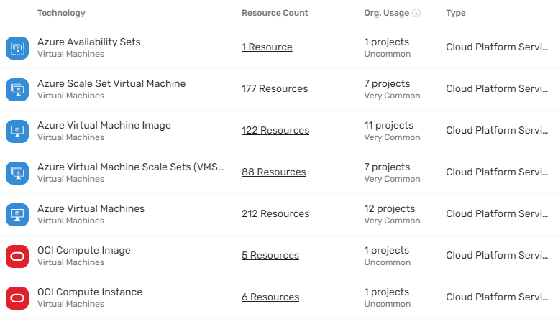
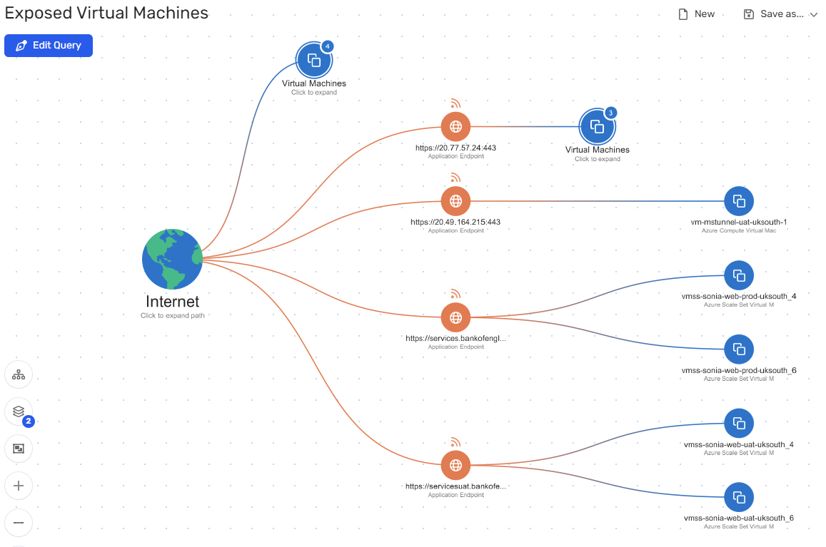
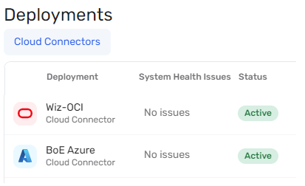
The Winning Solution
Inventory
Insights
Connectivity

